Slide 1
Environmental Studies
Name : Tushar Mamadge
Roll no: 2237073
Department : Artificial Intelligence and Data Science

Slide 2
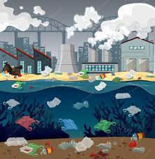
CONTENT
UNIT 1: Introduction to Environment Pollution
UNIT 2: Water Pollution
UNIT 3: Air Pollution and Noise Pollution
UNIT 4: E-Waste Management and Green computing

Slide 3
Unit 1 : Environment Pollution
Environment pollution can be defined as any undesirable change in physical , chemical or biological characteristics of any component of the environment .
POLLUTION: The term pollution refers to influence of any substance causing harmful effect to human beings and other organism.
POLLUTANT: Any substance causing Nuisance or uneasiness is called as pollutant.

Slide 4
INTRODUCTION
A health ecosystem for the protection of all living things is utterly necessary.
Government and public action to reduce environment pollution should be taken promptly on time.
Instead of personal vehicles , we should depend as much as possible on public transport.

Slide 5
TYPES OF POLLUTION
THERE ARE VARIOUS TYPES OF POLLUTION :
AIR POLLUTION
NOISE POLLUTION
E-WASTE
SOUND POLLUTION

